Slide 1
Team HelpYa
Problem Statement : Help me with my mood

Slide 2
Team Members and Roles:
1)Nikhil Kolte - Android
2) Abhishek Kulkarni - Data Analysis Module
3)Pranav Kajgaonkar - Data Analysis Module
4)Pratul Trivedi - Database Module

Slide 3
Tools/Platform/APIs used in the solution:
APIs:
IBM Watson Developer Cloud (Tone Analyzer)
IBM Cloudant (NoSql DB)
Platforms Used:
Android Studio
PyCharm
PythonAnywhere(PaaS)

Slide 4
Tools/Platform/APIs used in the solution:
Tools/Languages:
Java/ Android
Python 3.x
CouchDB
SQLite

Slide 5
Key functionalities of the developed solution:
Monitors the social media day-to-day activities of the user and analyses the same to give suggestions.
Uses past history analysis to understand the behavioural pattern of the user (eg. His weekday behaviour or weekends behaviour).
Show user’s mood throughout the day and provides the graphical representation of the same.
User-friendly UI, to get a swift run throughout the application.

Slide 6
Usage of IBM Cloud/ IBM Services
IBM Watson:
Used Tone Analyzer for evaluating the user’s mood by analysing user’s social media activities.
IBM Cloudant:
Used Cloudant Service as a database for the application.

Slide 7
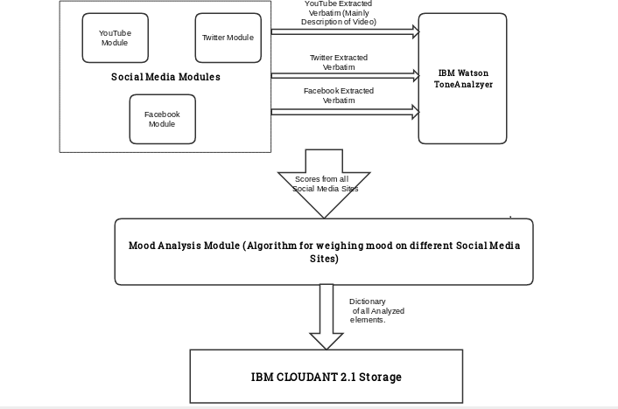
Process Flow:

Slide 8
Process Flow Description:
Social Media Modules are specifically for data extraction purpose. (e.g. YouTube Module is for extracting Video Name, Description given and Hashtags, if any),
Extracted Entities of Social Media Modules are passed on as a whole verbatim to get tone scores for every statement of text document using the Tone Analyzer API.
Scores of different Social Media sites are sent on to the Mood Analysis Module, which has an algorithm to determine which social media site should have highest weightage to decide user's emotion, based on the content.
Final result, which is in form of Dictionary, is stored in IBM CLOUDANT. Which can used for further analysis.
This process continues daily, generating more and more data while the algorithm getting better every day.

Slide 9
Working of Android Application:
Open the MoodAnalyser app. A welcome message will be displayed and the user will be prompted to Login or Register.
Existing users should login with their user name and password. While new users should Register. > For registration the user should enter his “Twitter Username” first. Username can be found on www.twitter.com/profile > Then on the next page user should enter his/her Facebook graph api key. Detailed instructions for getting the api key will be displayed on the screen. > After that the user will be prompted for his/her YouTube api key and channel id. Instructions to get the same will be displayed on the screen. > That’s it, the new user will now can access the MoodAnalyser application.
After logging in, user can see his/her mood analysis for the previous day.
User will see a prompt, an inspirational quote and a video according to the detected mood.
User will also be able to see the detailed analysis of the recorded mood in the form of graphs.

Slide 10
Application Video Link
https://tinyurl.com/MoodAnalyser

